Slide 1


Slide 2
Management Yesterday and Today
Chapter
2
© 2007 Prentice Hall, Inc.
All rights reserved.

Slide 3

Historical Background of Management
Scientific Management
  Describe the important contributions made by Fredrick W. Taylor
General Administrative Theory
Quantitative Approach
Toward Understanding Organizational Behavior
The Systems Approach The Contingency Approach
Current Issues and Trends
2–<number>

Slide 4
Ancient Management
  Egypt (pyramids) and China (Great Wall)
Adam Smith
  Published “The Wealth of Nations” in 1776
    Advocated the division of labor (job specialization) to increase the productivity of workers
Industrial Revolution
  Substituted machine power for human labor
  Created large organizations in need of management
© 2007 Prentice Hall, Inc. All rights reserved.
2–<number>

Slide 5
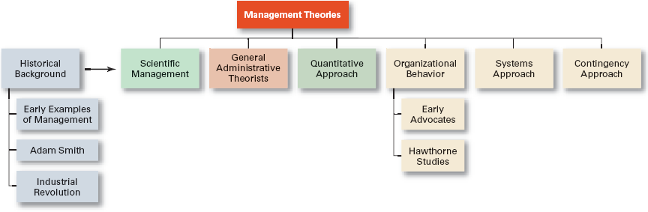
Exhibit 2–1 Development of Major Management Theories
© 2007 Prentice Hall, Inc. All rights reserved.
2–<number>

Slide 6

Major Approaches to Management
Scientific Management
General Administrative Theory
Quantitative Management
Organizational Behavior
Systems Approach
Contingency Approach
© 2007 Prentice Hall, Inc. All rights reserved.
2–<number>

Slide 7
Scientific Management
Fredrick Winslow Taylor
  The “father” of scientific management
  Published Principles of Scientific Management (1911)
    The theory of scientific management
      Using scientific methods to define the “one best way” for a job to be done:
        Putting the right person on the job with the correct tools and equipment.
        Having a standardized method of doing the job.
        Providing an economic incentive to the worker.
© 2007 Prentice Hall, Inc. All rights reserved.
2–<number>

Slide 8
Exhibit 2–2 Taylor’s Four Principles of Management
Develop a science for each element of an individual’s work, which will replace the old rule-of-thumb method.
Scientifically select and then train, teach, and develop the worker.
Heartily cooperate with the workers so as to ensure that all work is done in accordance with the principles of the science that has been developed.
Divide work and responsibility almost equally between management and workers. Management takes over all work for which it is better fitted than the workers.
© 2007 Prentice Hall, Inc. All rights reserved.
2–<number>

Slide 9
Scientific Management (cont’d)
How Do Today’s Managers Use Scientific Management?
  Use time and motion studies to increase productivity
  Hire the best qualified employees
  Design incentive systems based on output
© 2007 Prentice Hall, Inc. All rights reserved.
2–<number>

Slide 10
General Administrative Theory
Henri Fayol
  Believed that the practice of management was distinct from other organizational functions
  Developed fourteen principles of management that applied to all organizational situations
Max Weber
  Developed a theory of authority based on an ideal type of organization (bureaucracy)
    Emphasized rationality, predictability, impersonality, technical competence, and authoritarianism
© 2007 Prentice Hall, Inc. All rights reserved.
2–<number>

Slide 11
Exhibit 2–3 Fayol’s 14 Principles of Management
Division of work.
Authority.
Discipline.
Unity of command.
Unity of direction.
Subordination of individual interests to the general interest.
Remuneration.
Centralization.
Scalar chain.
Order.
Equity.
Stability of tenure of personnel.
Initiative.
Esprit de corps.
© 2007 Prentice Hall, Inc. All rights reserved.
2–<number>

Slide 12
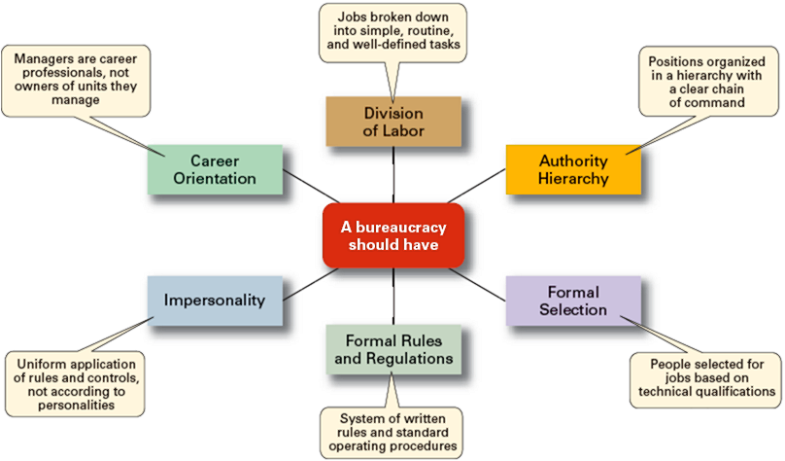
Exhibit 2–4 Weber’s Ideal Bureaucracy
© 2007 Prentice Hall, Inc. All rights reserved.
2–<number>

Slide 13
Quantitative Approach to Management
Quantitative Approach
  Also called operations research or management science
  Evolved from mathematical and statistical methods developed to solve WWII military logistics and quality control problems
  Focuses on improving managerial decision making by applying:
    Statistics, optimization models, information models, and computer simulations
© 2007 Prentice Hall, Inc. All rights reserved.
2–<number>

Slide 14

Understanding Organizational Behavior
Organizational Behavior (OB)
  The study of the actions of people at work; people are the most important asset of an organization
© 2007 Prentice Hall, Inc. All rights reserved.
2–<number>

Slide 15
The Hawthorne Studies
A series of productivity experiments conducted at Western Electric from 1927 to 1932.
Experimental findings
  Productivity unexpectedly increased under imposed adverse working conditions.
  The effect of incentive plans was less than expected.
Research conclusion
  Social norms, group standards and attitudes more strongly influence individual output and work behavior than do monetary incentives.
© 2007 Prentice Hall, Inc. All rights reserved.
2–<number>

Slide 16
The Systems Approach
System Defined
  A set of interrelated and interdependent parts arranged in a manner that produces a unified whole.
Basic Types of Systems
  Closed systems
    Are not influenced by and do not interact with their environment (all system input and output is internal).
  Open systems
    Dynamically interact to their environments by taking in inputs and transforming them into outputs that are distributed into their environments.
© 2007 Prentice Hall, Inc. All rights reserved.
2–<number>

Slide 17
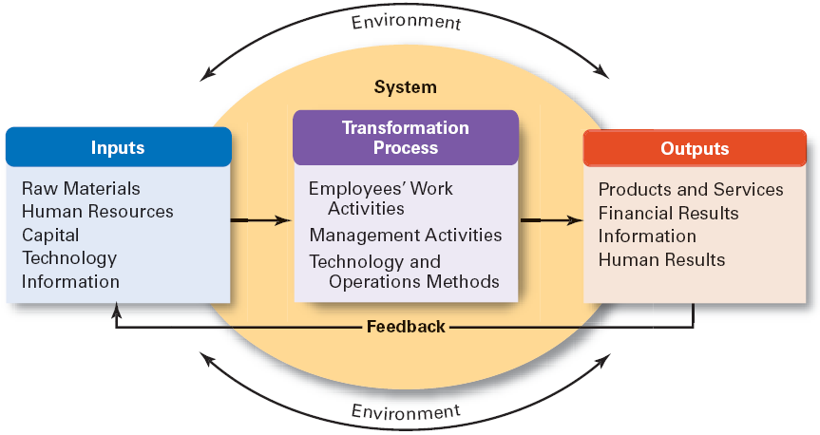
Exhibit 2–6 The Organization as an Open System
© 2007 Prentice Hall, Inc. All rights reserved.
2–<number>

Slide 18
The Contingency Approach
Contingency Approach Defined
  Also sometimes called the situational approach.
  There is no one universally applicable set of management principles (rules) by which to manage organizations.
  Organizations are individually different, face different situations (contingency variables), and require different ways of managing.
© 2007 Prentice Hall, Inc. All rights reserved.
2–<number>

Slide 19


© 2007 Prentice Hall, Inc. All rights reserved.
2–<number>

Slide 20

Current Trends and Issues
Globalization
Ethics
Workforce Diversity
Entrepreneurship
E-business
Knowledge Management
Learning Organizations
Quality Management
© 2007 Prentice Hall, Inc. All rights reserved.
2–<number>

Slide 21
Current Trends and Issues (cont’d)
Globalization
  Management in international organizations
  Political and cultural challenges of operating in a global market
    Working with people from different cultures
    Coping with anticapitalist backlash
    Movement of jobs to countries with low-cost labor
Ethics
  Increased emphasis on ethics education in college curriculums
  Increased creation and use of codes of ethics by businesses
© 2007 Prentice Hall, Inc. All rights reserved.
2–<number>

Slide 22
Current Trends and Issues (cont’d)
Workforce Diversity
  Gender
  minority
  ethnic
  Aging workforce
© 2007 Prentice Hall, Inc. All rights reserved.
2–<number>

Slide 23
Current Trends and Issues (cont’d)
Entrepreneurship Defined
  The process of starting new businesses, generally in response to opportunities.
Entrepreneurship process
  Pursuit of opportunities
  Innovation in products, services, or business methods
  Desire for continual growth of the organization
© 2007 Prentice Hall, Inc. All rights reserved.
2–<number>

Slide 24
Current Trends and Issues (cont’d)
E-Business (Electronic Business)
© 2007 Prentice Hall, Inc. All rights reserved.
2–<number>

Slide 25
Current Trends and Issues (cont’d)
Learning Organization
  An organization that has developed the capacity to continuously learn, adapt, and change.
Knowledge Management
  The cultivation of a learning culture where organizational members systematically gather and share knowledge with others in order to achieve better performance.
© 2007 Prentice Hall, Inc. All rights reserved.
2–<number>

Slide 26
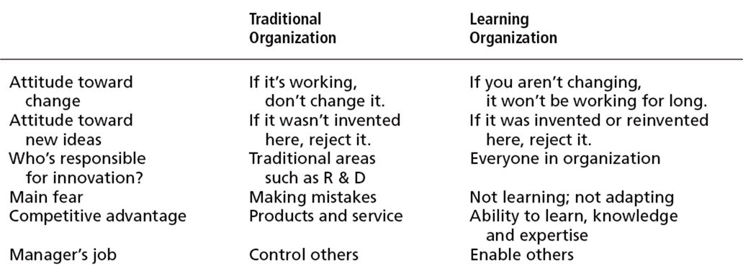
Exhibit 2–10 Learning Organization versus Traditional Organization
© 2007 Prentice Hall, Inc. All rights reserved.
2–<number>

Slide 27
Current Trends and Issues (cont’d)
Quality Management
  A philosophy of management driven by continual improvement in the quality of work processes and responding to customer needs and expectations
  Inspired by the total quality management (TQM) ideas of Deming and Juran
  Quality is not directly related to cost
  Poor quality results in lower productivity
© 2007 Prentice Hall, Inc. All rights reserved.
2–<number>

Slide 28

Apply all the concepts of management discussed so far in the class on the organization
Times new roman font 12
Soft copy email
© 2007 Prentice Hall, Inc. All rights reserved.
2–<number>

